Slide 1
Week 10 Presentation
Wednesday, October 30, 2019
ATLAS Data analyst team:
Smruthi Iyengar
Kagen Jet Quiballo
Hanqing Wang
Yuxin Wang
Notes:
Welcome to our week 9 presentation. We are ATLAS Data Mining team. [self intro based on the list, name, major, title] The objective of this project is to study what impacts students’ matriculation from a financial perspectives.

Slide 2
Introduction
This week: Financial aid and Financial hold
Classify financial aid into two categories
Financial Aid distributions
Payment Methods
Predictive analysis
Notes:
For this week, first we are going to talk about the overview dropout from fall 17 all the way to Sp19 semester by semester. Then, we are going to focus on the dropout rate based on specific categories, like dropout rate by different groups, by colleges, by hold and by residency. Thus, I will leave the stage to Kagen.

Slide 3
Financial Aid (from ‘updated 9/30’)
GIFT AID
SELF-HELP AID
DISCRETIONARY FEE WAIVER
DISCRETIONARY TUITION WAIVER
STATUTORY FEE WAIVER
STATUTORY TUITION WAIVER
TUITION WAIVER
ESTIMATED SCHOLARSHIP
GENERAL SCHOLARSHIP
SCHOLARSHIP
GRANT
PRIZE AWARD
UIC GRANT/AWARD
BENEFIT
EXEMPTION
WORK
LOAN
Notes:
Take a look at loans only - 70% graduate with loans. Of those that don’t continue, how many have loans

Slide 4
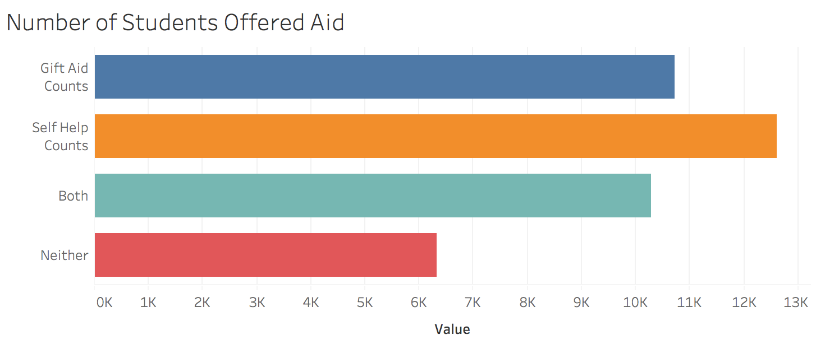
Distributions Total F17-F18 undergrads (scope): 19,454 students
10,726
12,603
10,297
6,319

Slide 5
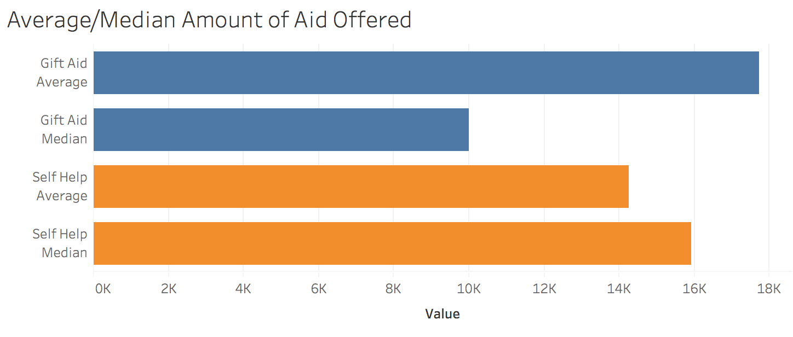
Distributions Total F17-F18 undergrads (scope): 19,454 students
$17,714
$10,000
$14,249
$15,926
Notes:
Do not consider work

Slide 6
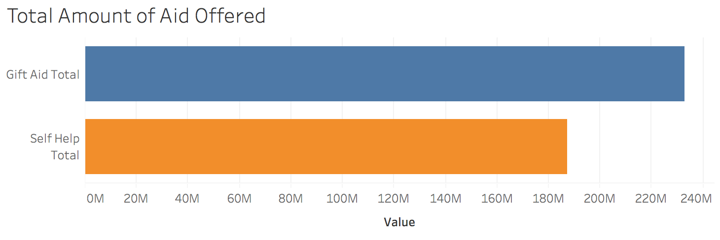
Distributions Total F17-F18 undergrads (scope): 19,454 students
$232.7M
$187.18M

Slide 7
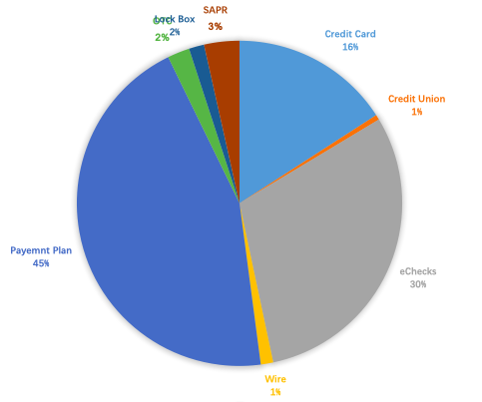
Payment Method (from new data set)
Credit Card
Credit Union
eChecks
Wire + Flywire
Payment Plan
OTC
Lock Box
SAPR
26015
833
49635
2030
73527
3609
2478
5747
Payroll Deduction, Sponsor Billing, and wire-off: Each was chosen by less than 250 students.
On-Plan and Chapter 33 are payments on past due accounts.

Slide 8
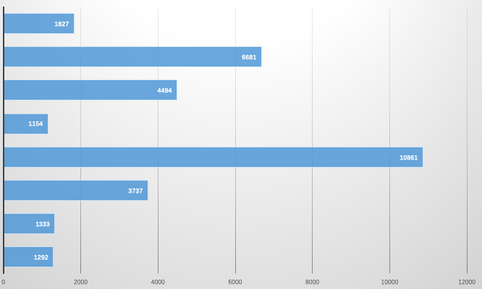
Payment Method: Average Payment Amount
Credit Card
Credit Union
eChecks
Wire + Flywire
Payment Plan
OTC
Lock Box
SAPR
$1292
$1333
$3737
$10861
$1154
$4494
$6681
$1827
Notes:
Wire and Flywire have a much larger payment amount: International students use Flywire to pay their tuition and fees, which are higher than native students’ tuition and fees

Slide 9

Predictive Analysis Questions
Are students from a specific college or degree program more or less likely to receive financial aid?
Answer: 9-sample test for equality of proportions in R
p < 0.05 → reject H_{O}
Not all proportions are equal
COLLEGE | STUDENTS IN COLLEGE | HOW MANY RECEIVED AID | PERCENTAGE
LAS | 9,691 | 6,649 | 68.61%
Engineering | 3,604 | 2,285 | 63.40%
Business | 2,987 | 1,952 | 65.35%
Arch/Design/Art | 1,064 | 728 | 68.42%
App. Health Sci | 999 | 694 | 69.47%
Nursing | 477 | 289 | 60.59%
Education | 388 | 256 | 65.98%
Urb Planning | 147 | 105 | 71.43%
Public Health | 97 | 73 | 75.26%
ALL COLLEGES | 19,454 | 13,031 | 66.98%

Slide 10
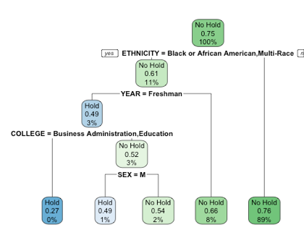
Predictive Analysis Questions
What type of students are more or less likely to receive a financial hold?
25% of undergraduates received a hold either in fall 2017 or spring 2018
Most likely to get a hold
Black or Multi-Race, Freshman (49%)
Black or Multi-Race,Freshman,Male,Not in Business or Education(49%)
Black or Multi-Race,Freshman,In Business or Education(27%)
Notes:
Include AUC

Slide 11
Conclusion
In each college, the proportion of undergraduate students who receive financial aid is close to each other, but not equal.
Majority of Students who receive the financial aid tend to have both self-help and gift aid financial aid
Black or Multi-Race Freshmen who is not in Business and Education college are more likely to receive a hold than students from other categories.

Slide 12
Thank you for listening!
Questions?

